Slide 1
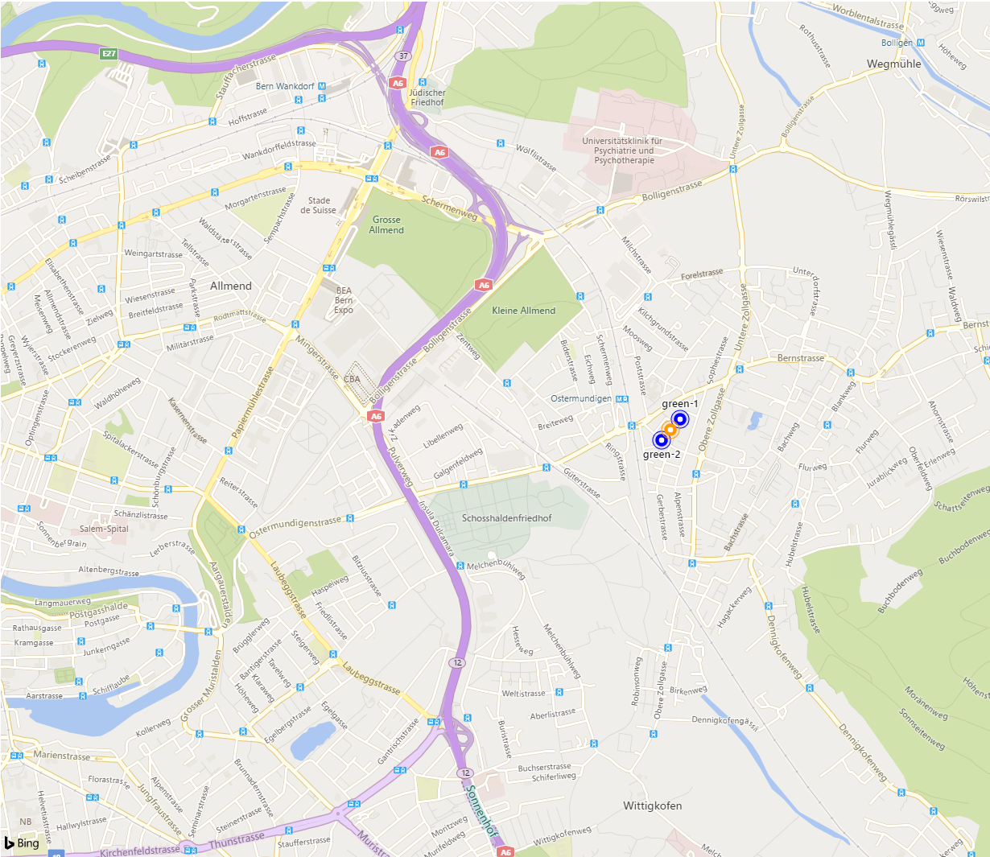
Scavenger Hunt
ASE Project by Pascal Gerig, Lorenzo Wipfli, Elias Wipfli and Marcel Zauder

Slide 2
Initial Ideas
Commander can see where the runner is on the map
Commander can see where the random-generated treasure is
Commander can manipulate Thingy
Game is over when Runner is at the treasure location
Two teams can play the game simultaneously
Each commander needs an authentification
When game completed, the path of each player is displayed on the screen
EMP implementation (instruction sending can be jammed)
All of them were implemented!

Slide 3
Additional Features
Complete Containerization with Docker
Automated Unittests with GitHub-Action
Integration Test of Database (redis-db)
ESlint SetUp in Frontend
Access of constants via environment set up

Slide 4
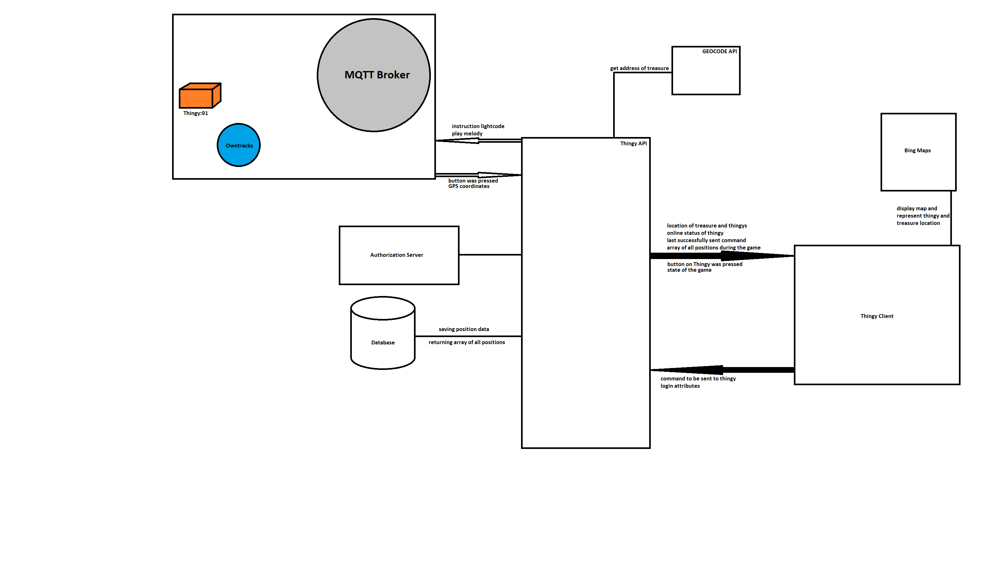
Architecture

Slide 5
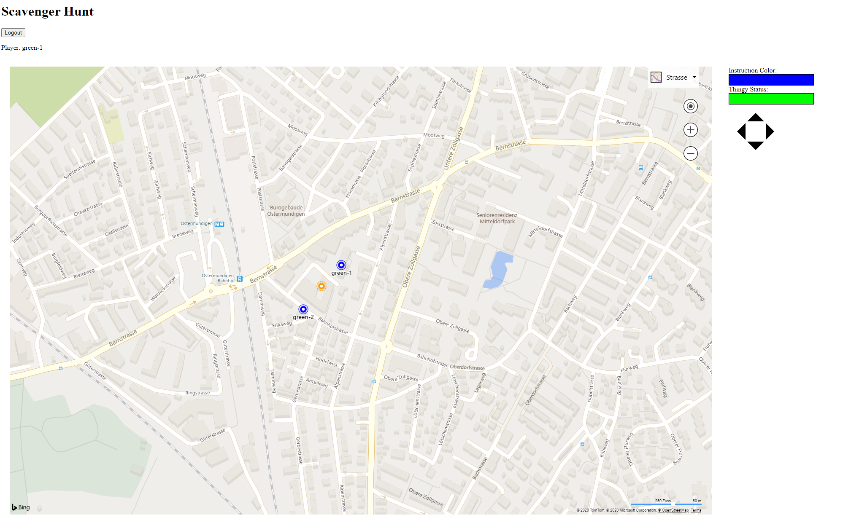
Browser Representation

Slide 6
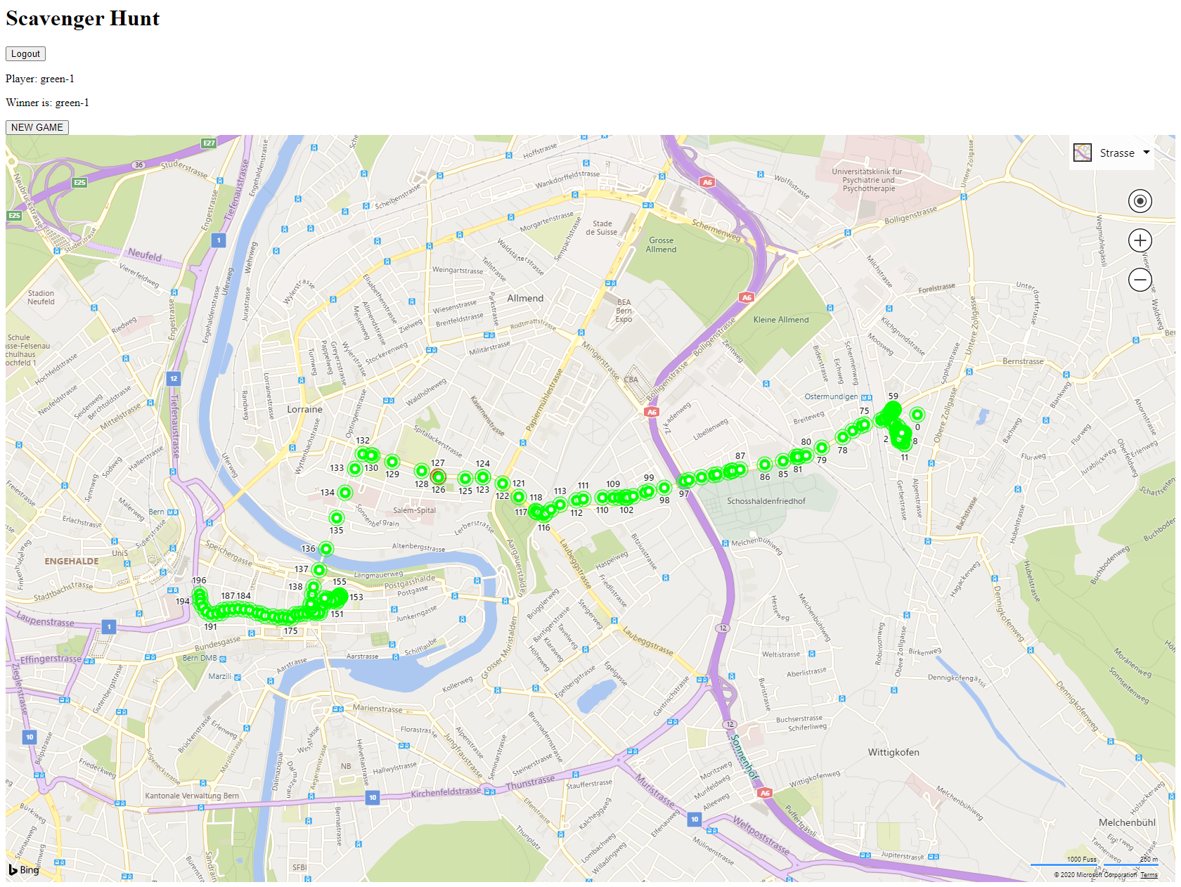
GameOver Screen

